Slide 1

Department Of Computer Science and Engineering
Vehicle Monitoring System In A Gated Community
Batch-17
2111CS010073 - S.Ashwanth Reddy
2111CS010052 - B.Anusha 2111CS010057 -Arbaz Ali Mohammed
2111CS010077 - Azeed Shaik
Guide
Dr P.Rambabu

Slide 2
Title Explanation
The title "Vehicle Monitoring System in a Gated Community Using Deep Learning" refers to the creation of a system that uses deep learning techniques to monitor and analyze vehicle movements within a residential gated community. The system employs advanced Convolutional Neural Networks (CNNs) to detect, track, and evaluate vehicles at entry and exit points as well as throughout the community. By automating the surveillance process, it enhances the accuracy of vehicle identification and anomaly detection, providing real-time alerts for suspicious activities. This approach aims to improve overall security and reduce dependence on manual monitoring methods.

Slide 3
Abstract
This project focuses on developing a deep learning-based system for monitoring vehicle movement in gated communities, aiming to enhance security and efficiency. Using Convolutional Neural Networks (CNNs) for object detection and tracking, the system can identify and monitor vehicles at entry and exit points, as well as within the community. The implementation utilizes tools like TensorFlow and OpenCV for model training and image processing. The core components of the project involve object detection to identify vehicles,image classification to categorize them (cars,bikes,trucks,etc.), and vehicle tracking to count entries and exits. The system’s output provides valuable data for applications such as security surveillance, traffic management, and resource optimization, improves accuracy, and ensures quicker response to potential security threats, thereby contributing to safer residential environments.

Slide 4
Introduction
The project aims to enhance security in gated communities by developing a deep learning-based system to monitor vehicle movement. Traditional manual surveillance methods can be inefficient and error-prone, making it difficult to ensure real-time monitoring and response. This system leverages Convolutional Neural Networks (CNNs) to detect, track, and analyze vehicles at entry and exit points, as well as within the community. Tools like TensorFlow and OpenCV are used for model training and image processing. By automating vehicle monitoring, the system improves accuracy, reduces human error, and strengthens the overall security framework, contributing to a safer residential environment.

Slide 5
Problem Statement
In gated communities, ensuring the security of residents is challenging due to the limitations of traditional surveillance methods, which rely heavily on manual monitoring. These methods are often inefficient, prone to human error, and incapable of providing real-time detection of suspicious vehicle activities. The lack of automated, accurate monitoring increases the risk of unauthorized access and delays in responding to potential security threats. There is a need for an advanced system that can continuously and reliably monitor vehicle movement, identify anomalies, and assist in maintaining a secure environment without overburdening human resources.

Slide 6
Objective
1. Develop an Automated Monitoring System: Create a deep learning-based system to automatically detect, track, and analyze vehicle movement within a gated community.
2. Enhance Security and Accuracy: Utilize Convolutional Neural Networks (CNNs) and advanced image processing tools to improve the accuracy of vehicle identification and anomaly detection, reducing reliance on manual surveillance.
3. Enable Real-Time Response: Implement a system that provides real-time alerts for suspicious vehicle activities, allowing for quicker and more effective responses to potential security threats.

Slide 7
Methodology
Data Collection and Preparation:
- Gather Data: Collect video footage and images of vehicles in various conditions (e.g., different angles, lighting, and weather conditions) within the gated community.
- Label Data: Annotate the collected data with relevant information, such as vehicle type, license plate number, and movement patterns, to create a training dataset.
2. Model Development:
- Select Algorithms: Utilize Convolutional Neural Networks (CNNs) for object detection and tracking. Choose appropriate architectures (e.g., YOLO, Faster R-CNN) based on accuracy and performance requirements.
- Train Model: Train the CNN using the labeled dataset to recognize and track vehicles. Adjust hyperparameters and fine-tune the model to improve performance.

Slide 8
3. Integration and Implementation:
- Develop System: Implement the trained model using frameworks like TensorFlow for model deployment and OpenCV for real-time video processing.
- Integrate with Surveillance Systems: Connect the model to existing security cameras and infrastructure within the community for seamless operation.
4. Testing and Evaluation:
- Evaluate Performance: Test the system's accuracy, reliability, and responsiveness in real-world scenarios. Assess its ability to detect and track vehicles and generate alerts for suspicious activities.
- Refine System: Based on test results, make necessary adjustments to improve detection accuracy, reduce false positives, and enhance overall system performance.
5. Deployment and Monitoring:
- Deploy System: Roll out the system across the gated community and ensure integration with existing security operations.
- Monitor and Maintain: Continuously monitor system performance and update the model as needed to adapt to changing conditions and improve effectiveness.

Slide 9
from track import *
import tempfile
import cv2
import torch
import streamlit as st
import os
def display_footer():
footer_text = """
<div style="background-color:#F5F5DC; padding: 10px; border-radius: 5px;">
<center><h2>Vehicle Monitoring System in Community</h2><br>
<h3>Done By:</h3><br><h3>Azeed.Sk</h3> <br>
<h3>Anusha.B </h3><br>
<h3>Arbaz Ali.Mohammad </h3><br>
<h3>Ashwanth Reddy.S</h3> <br>
<h3>Guided By: DR.Ramababu.P Prof. Mruh </h3><br>
<h3>All Copyrights @ Reserved 2024</h3></center>
</div>
"""
st.markdown("<hr>", unsafe_allow_html=True)
st.markdown(f'<p style="text-align: center; color: black;">{footer_text}</p>', unsafe_allow_html=True)
if __name__ == '__main__':
st.title('vehicle monitoring system in a gated community')
st.markdown('<h3 style="color: red"> with Yolov5 and Deep Learning </h3', unsafe_allow_html=True)
# upload video
video_file_buffer = st.sidebar.file_uploader("Upload a video", type=['mp4', 'mov', 'avi'])

Slide 10
if video_file_buffer:
st.sidebar.text('Input video')
st.sidebar.video(video_file_buffer)
# save video from streamlit into "videos" folder for future detect
with open(os.path.join('videos', video_file_buffer.name), 'wb') as f:
f.write(video_file_buffer.getbuffer())
st.sidebar.markdown('---')
st.sidebar.title('Settings')
# custom class
custom_class = st.sidebar.checkbox('Custom classes')
assigned_class_id = [0, 1, 2, 3]
names = ['car', 'motorcycle', 'truck', 'bus']
if custom_class:
assigned_class_id = []
assigned_class = st.sidebar.multiselect('Select custom classes', list(names))
for each in assigned_class:
assigned_class_id.append(names.index(each))
# st.write(assigned_class_id)
# setting hyperparameter
confidence = st.sidebar.slider('Confidence', min_value=0.0, max_value=1.0, value=0.5)
line = st.sidebar.number_input('Line position', min_value=0.0, max_value=1.0, value=0.6, step=0.1)
st.sidebar.markdown('---')

Slide 11
status = st.empty()
stframe = st.empty()
if video_file_buffer is None:
status.markdown('<font size= "4"> **Status:** Waiting for input </font>', unsafe_allow_html=True)
else:
status.markdown('<font size= "4"> **Status:** Ready </font>', unsafe_allow_html=True)
car, bus, truck, motor = st.columns(4)
with car:
st.markdown('**Car**')
car_text = st.markdown('__')
with bus:
st.markdown('**Bus**')
bus_text = st.markdown('__')
with truck:
st.markdown('**Truck**')
truck_text = st.markdown('__')
with motor:
st.markdown('**Motorcycle**')
motor_text = st.markdown('__')
fps, _, _, _ = st.columns(4)
with fps:
st.markdown('**FPS**')
fps_text = st.markdown('__')

Slide 12
track_button = st.sidebar.button('START')
# reset_button = st.sidebar.button('RESET ID')
if track_button:
# reset ID and count from 0
reset()
opt = parse_opt()
opt.conf_thres = confidence
opt.source = f'videos/{video_file_buffer.name}'
status.markdown('<font size= "4"> **Status:** Running... </font>', unsafe_allow_html=True)
with torch.no_grad():
detect(opt, stframe, car_text, bus_text, truck_text, motor_text, line, fps_text, assigned_class_id)
status.markdown('<font size= "4"> **Status:** Finished ! </font>', unsafe_allow_html=True)
# end_noti = st.markdown('<center style="color: blue"> FINISH </center>', unsafe_allow_html=True)
# Display the footer
display_footer()
# if reset_button:
# reset()
# st.markdown('<h3 style="color: blue"> Reseted ID </h3>', unsafe_allow_html=True)

Slide 13
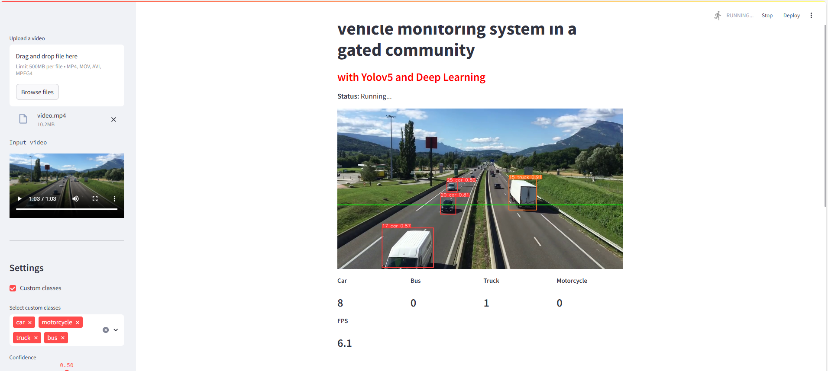

Slide 14
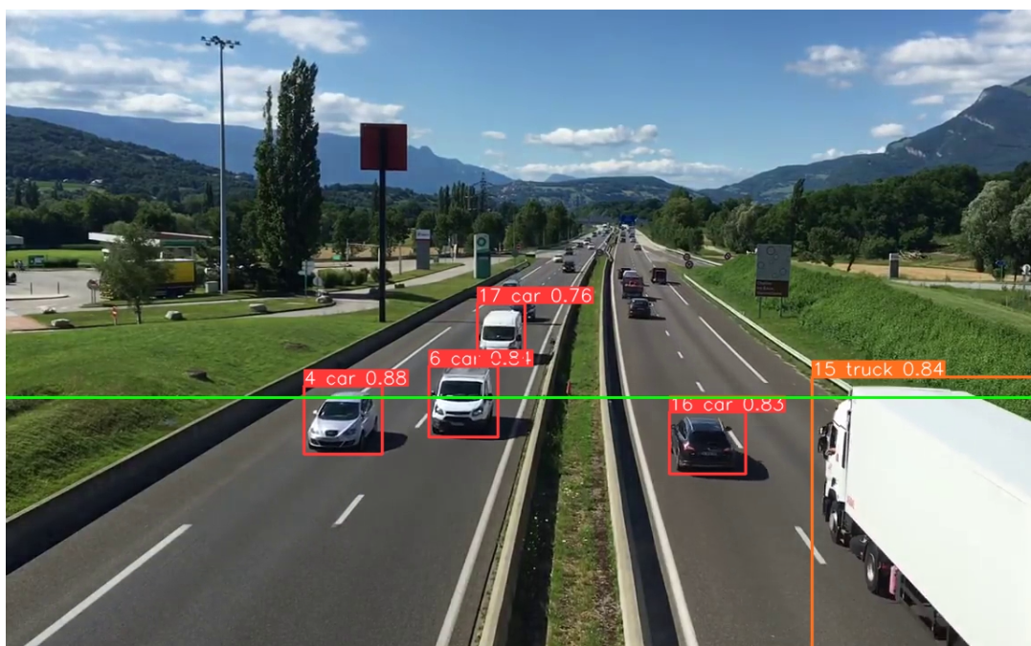

Slide 15
Conclusion
This deep learning-based vehicle monitoring system significantly improves security in gated communities by providing automated, real-time tracking and analysis of vehicle movements. Utilizing Convolutional Neural Networks (CNNs) enhances accuracy and reduces the need for manual surveillance, leading to more effective detection of suspicious activities. The successful deployment of this system contributes to a safer and more secure environment, demonstrating the valuable application of advanced technology in residential security.

Slide 16
References
S. Ren, K. He, R. Girshick, and C. Sun, "Faster R-CNN: Towards Real-Time Object Detection with Region Proposal Networks," IEEE Transactions on Pattern Analysis and Machine Intelligence, vol. 39, no. 6, pp. 1137-1149, June 2017.
J. Redmon, S. Divvala, R. Girshick, and A. Farhadi, "You Only Look Once: Unified, Real-Time Object Detection," IEEE Conference on Computer Vision and Pattern Recognition (CVPR), pp. 779-788, 2016.
A. Krizhevsky, I. Sutskever, and G. Hinton, "ImageNet Classification with Deep Convolutional Neural Networks," Advances in Neural Information Processing Systems (NeurIPS), pp. 1097-1105, 2012.
G. Bradski and A. Kaehler, Learning OpenCV: Computer Vision with the OpenCV Library, O'Reilly Media, 2008.

Slide 17
THANK YOU

